Slide 1
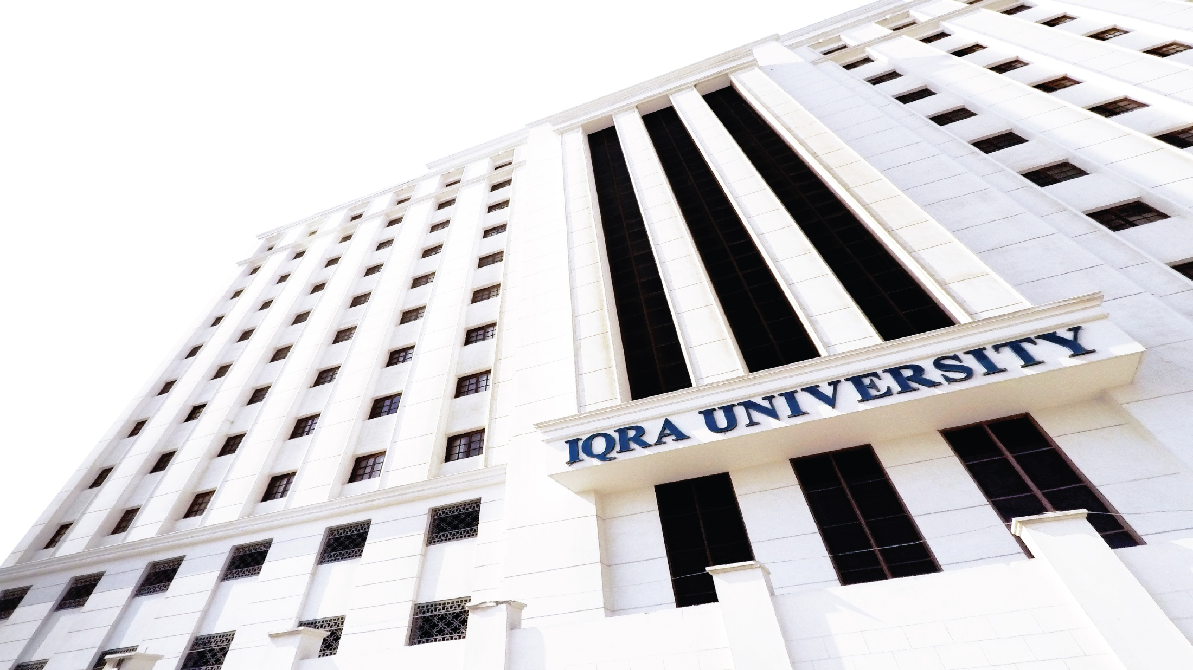

Causes and Impacts of Stress
Prepared by Dr. Rabia Mushtaq

Slide 2
Key Points
01
Causes of stress
02
Impacts of stress

Slide 3
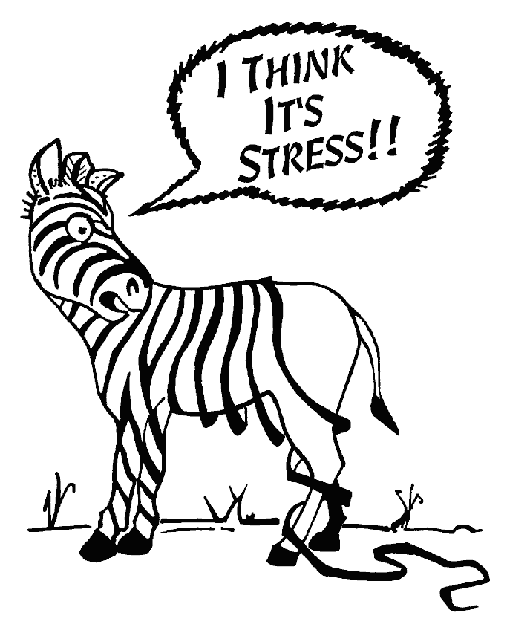

Slide 4

What Makes Something Stressful?
Situations that have strong demands
Situations that are forthcoming
Life transitions
Ambiguity
Desirability
Controllability

Slide 5
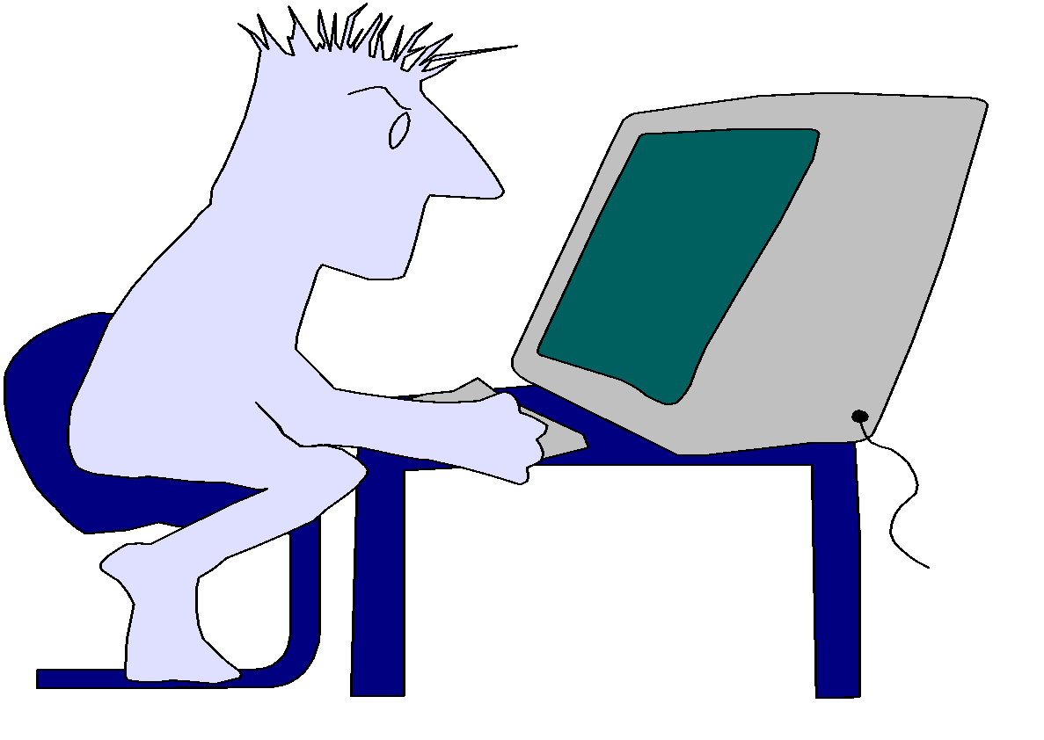
External Stressors
Physical Environment
Social Interaction
Organisational
Major Life Events
Daily Hassles

Slide 6
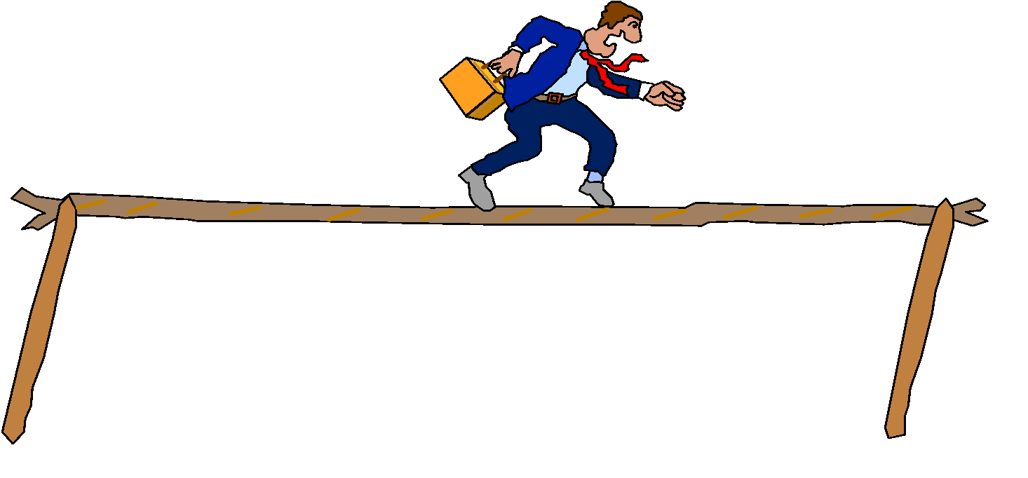
Internal Stressors
Lifestyle choices
Negative self - talk
Mind traps
Personality traits

Slide 7
What is Stressful to You?
Work | Retirement | Legal matters
Online Classes | Childcare | Mental health
Studying | Finances | Law violation
Relationship with partner | Appearance | Spiritual/Religious issues
Relationship with family | Physical Health | Major/Career decisions
Relationship with friends | Not “fitting in” | Attitudes/thoughts
Trauma | Getting married | Buying a house
Change in residence | Change to a new school | Change in amount of recreation
Change in amount of social activities | Change in eating habits | Death of friend/family member

Slide 8
Impacts of Stress
Mental health problems:
Depression, anxiety, suicidal ideation and personality issues
Physical health problems:
Cardiovascular disease,
High blood pressure and Stroke
Obesity and eating disorders
Sexual dysfunction,
Skin and hair problems, such as acne and eczema, and hair fall
Gastrointestinal problems, such as gastritis, ulcerative colitis, and irritable bowl syndrome
Cancer

Slide 9
Thank You

